Slide 1


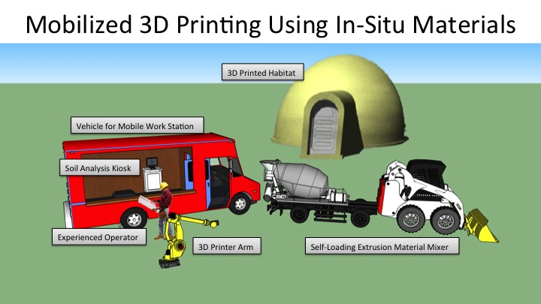
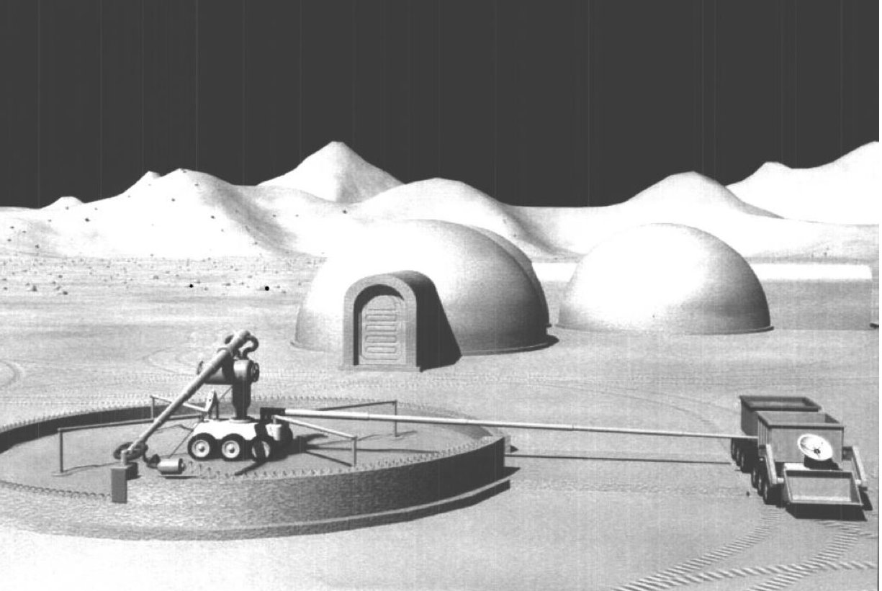
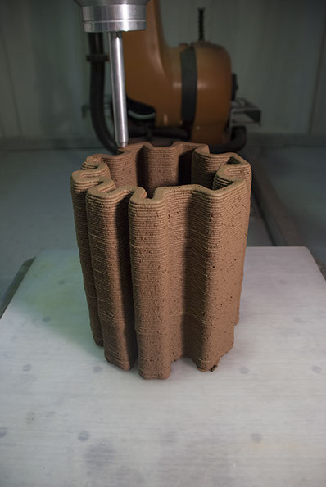
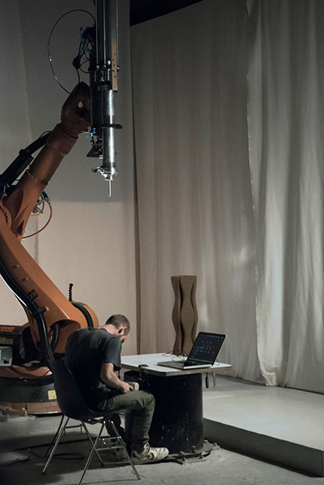
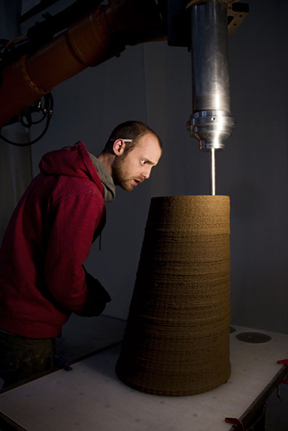
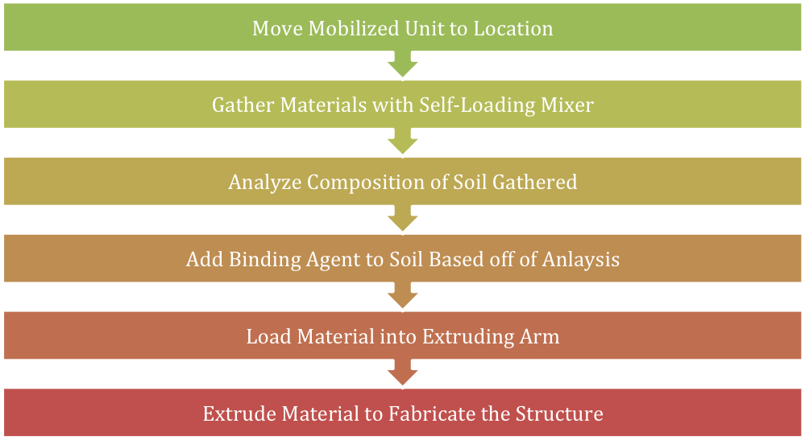
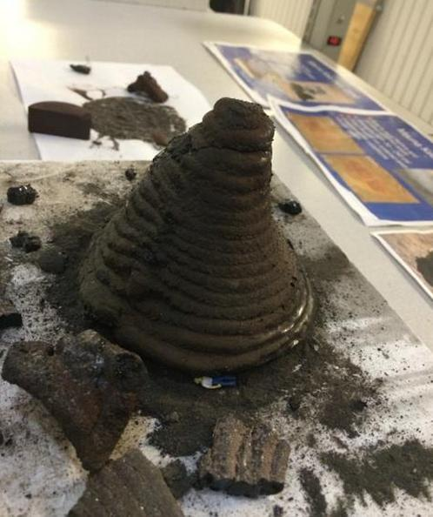
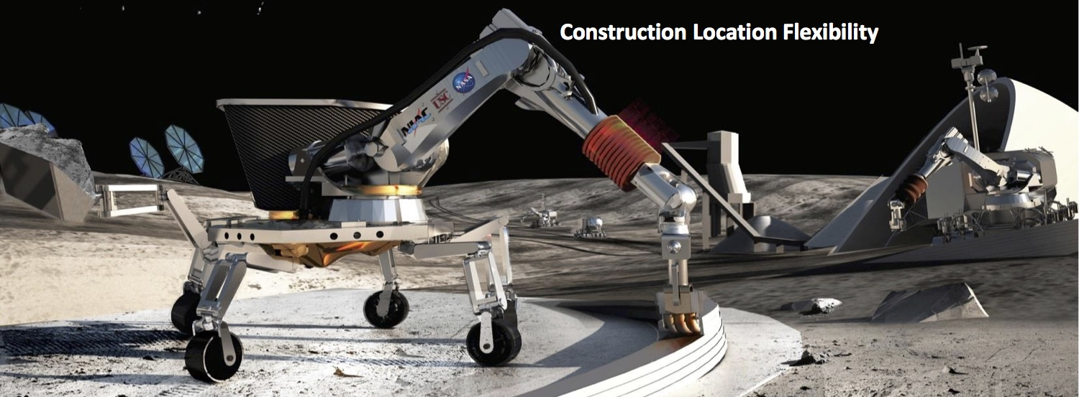
3D Printing Livable Structures Using In-Situ Materials
Tiler Rose • Southwestern Oklahoma State University • Department of Engineering Technology
INTRODUCTION & PROBLEM STATEMENT
APPLICATIONS OF THIS TECHNOLOGY
CONSIDERATIONS CONCERNING BINDING MATERIALS
By default, buildings are large, expensive and time-consuming to construct. One solution that has recently been explored by builders and inventors is using 3D printing technology to build structures such as office buildings, as well as homes for people to live in, whether it be temporarily or permanent. Compared to traditional construction methods, extruding buildings (similar to how you would extrude plastic in a run-of-the-mill 3D printer) has the potential to reduce costs and construction time. One issue that is still present in either method of the fabrication of buildings, however, is that construction materials must still be transported to the site of the project.
This technology, when developed, could be utilized in rural areas where structures are needed but costly. This could also be used in developed areas adversely affected by disaster situations, such as tornadoes, hurricanes, and fires, where quick shelter is needed and traditional building materials are not readily available.
What makes this project difficult to carry out is the chemistry aspect of the project, which involves the inclusion of binding agents to the soil. This is the aspect of the project that both NASA and Pylos are still conducting research on. In the research that I conducted on this topic, all of the 3rd party companies that currently conduct soil composition analysis do so for agricultural applications (“Geotechnical Investigations,” “LaMotte Complete Electronic Soil Lab – 1985-04,” “Soil classification”). It is possible that, until a technology is developed that allows non-chemists to conduct analyses on the site of construction, those operating the mobile 3D printing unit can send soil samples to these agricultural companies.
REQUIRED MACHINERY
SOLUTION
As previously stated, this project’s aim is to eliminate the final hurdles that prevent this technology from being in the hands of people on our planet that could benefit from it the most. Aspects of this project that differ from the two conducted by NASA and IAAC discussed above include the addition of trucks that would be large enough to facilitate the machinery that will be used throughout the fabrication process. Some of the machinery that would be used throughout the fabrication process consists of:
A mobilized 3D printing arm, most likely on small, castor-like wheels, that can be moved easily to the site of construction,
A self-loading concrete mixer to deploy in areas where building materials would need to be collected, and
Specialized testing equipment to assess the needs of each area to determine what composite materials would need to be brought and added to the local soil.
APPEARANCE OF FINAL PRODUCT
To eliminate this issue, builders would need to be able to extrude structures using materials readily available in whatever area they decide to build. Some have already begun research using this concept; two examples of those who hope to use a similar technology include NASA and the European Space Agency. They aspire to use readily available regolith (or soil that is not from the Earth) on both the Moon and Mars to 3D print structures structurally sound enough for our astronauts. Pylos, a private company based out of Barcelona, Spain has also dabbled in using soil to erect clay-like structures.
Concerning the appearance of what these habitats may look like, initially it is expected that these structures would not be especially aesthetically pleasing. It is more feasible that these initial buildings will look similar to the ones NASA has planned for their long duration extraterrestrial missions.
Labeled visual of components of the proposed mobilized 3D-printing process
POSSIBILITIES
NASA concept of extraterrestrial, mobilized 3D printing (Muller)
Possibilities that have not been done, or possibly even considered, concerning this technology include:
Commercializing this technology for use by the general population,
Mobilizing this technology for use in areas beyond the point of the product’s development, and
Developing a system to combine this technology with the unique soil makeups found in all of the different communities where this could potentially be used.
Current technological capabilities of Pylos in Barcelona, Spain (Giannakopoulos)
FINAL REMARKS
Having the ability to extrude structures using 3D printer-like technologies could prove to be very beneficial for people in need of quick, short-term shelter. This technology would be especially helpful if in-situ materials could be utilized, as opposed to the alternative, which would be to transport building materials to the building site. Commercializing and mobilizing this process would help a wide range of people. An item that was not directly discussed was the cost of the fabrication machinery, however this is difficult to estimate given the novelty of the technology. Costs aside, this technology has the potential to help a great number of people in need, and I hope that similar technologies are developed in the near future.
Example of process flow
MEANS OF ACCOMPLISHING DESIRED OUTCOME
COMBINING TECHNOLOGIES
This would be accomplished using means including:
Trucks large enough to facilitate the machinery that will be used throughout the fabrication process,
Self-loading concrete mixers to deploy in areas where building materials would need to be collected, and
Specialized testing equipment to assess the needs of each area to determine what composite materials would need to be brought and added to the local soil.
What would need to be accomplished from this point into the future is combining NASA’s concepts of mobilizing the technology with Pylos’s advanced 3D printing of Earth based soil capabilities. The only downside to this would be that companies like Pylos do not have the funding to put money into the development of this technology like NASA does, even though it is one of their objectives for the future of their technology (IAAC).
WORKS CITED & REFERENCED
Current & Proposed NASA mobilized regolith 3D printing technology (Krassenstein, Muller)
Available upon request

